Slide 1
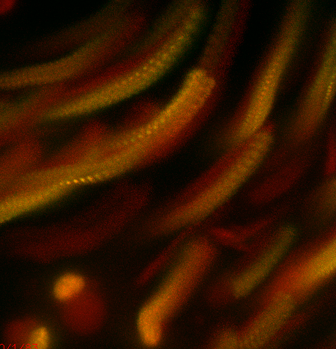
Live Cell Imaging
Notes:
1
For this class, I am going to talk to you live imaging and in particular 3-D fluororescence imaging. I know you had information about TIRF and DIC imaging and in later sections you will be talking about FRET, PALM/STORM. So I won’t touch upon those subjects. So instead I will be focusing on general challenges one finds when doing live imaging. I also will be using some data from my lab in trying to determine the kinetics of synapsis assembly during meiosis as a way to illustrate some of the important considerations one has to take when imaging a live biological process.
----- Meeting Notes (3/28/13 11:42) -----
Really this lecture should really be about distinguishing the living from the zombies, essentially the living dead.

Slide 2
Key Elements for Successful Live Imaging
Choice of biological system
Validation
Reducing photoxicity and photobleaching
Close preservation of normal environment

Slide 3
Choosing the Appropriate Organism to
Answer your Question
Easy labeling of your target of interest
Biological process can be found at sufficient frequency
Biological process completes in a reasonable amount of time
The process can be sustained over the time it takes to image
Not imaging a process that occurs too deep into the tissue
The time resolution isn’t beyond the imaging capabilities
Ways to validate your results?

Slide 4
Phototoxicity

Slide 5
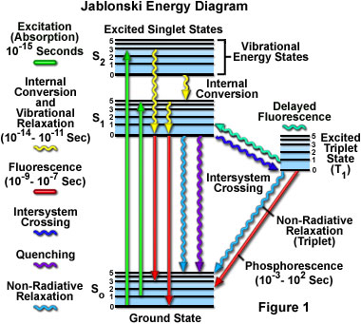
¹O₂
O₂
Notes:
Instead of emitting fluorescence, te energy is transferred to an triplet state which can convert O2 in the highly reactive singlet O2 state

Slide 6
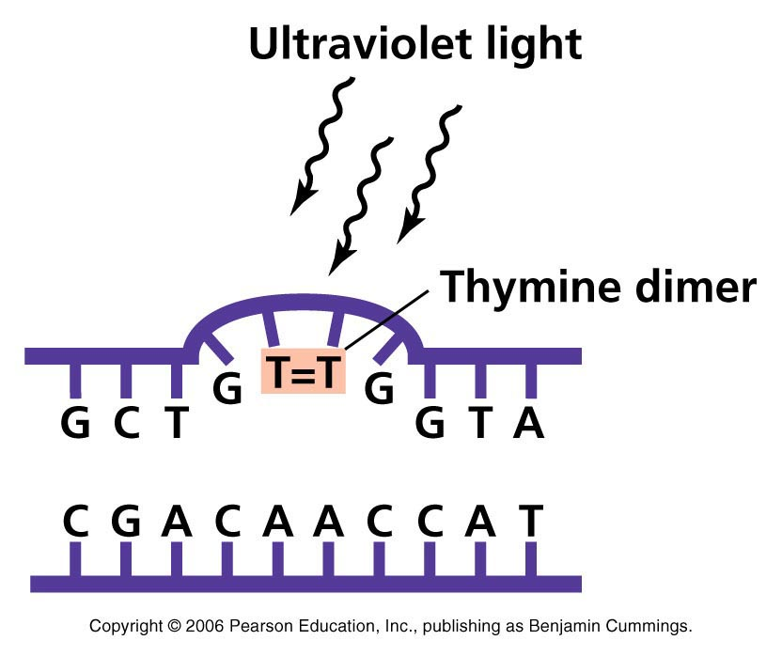
Biological Harmful Effects of Free Radicals
Because of its unpaired electron singlet O₂ will attack sites of high electron density -e.g. C=C, N atoms.
Lipid peroxidation
Protein modification
DNA modification
¹O₂
¹O₂
Notes:
Reactive oxygen species (ROS) is a phrase used to describe a variety of molecules and free radicals (chemical species with one unpaired electron) derived from molecular oxygen. Molecular oxygen in the ground state is a bi-radical, containing two unpaired electrons in the outer shell (also known as a triplet state). Since the two single electrons have the same spin, oxygen can only react with one electron at a time and therefore it is not very reactive with the two electrons in a chemical bond. On the other hand, if one of the two unpaired electrons is excited and changes its spin, the resulting species (known as singlet oxygen) becomes a powerful oxidant as the two electrons with opposing spins can quickly react with other pairs of electrons, especially double bonds.
The basis of PDT is the interaction of light with photosensitive agents to produce an energy transfer and a local chemical effect. This is broadly similar to what is seen in photosynthesis, although in this case, many photosensitizers work together to harvest light energy to produce chemical reactions. Of the many photosensitizers that have been used in PDT, each has its own unique excitation properties. Usually, the photosensitizer is excited from a ground singlet state to an excited singlet state. It then undergoes intersystem crossing to a longer-lived excited triplet state.
One of the few chemical species present in tissue with a ground triplet state is molecular oxygen. When the photosensitizer and an oxygen molecule are in proximity, an energy transfer can take place that allows the photosensitizer to relax to its ground singlet state, and create an excited singlet state oxygen molecule. Singlet oxygen is a very aggressive chemical species and will very rapidly react with any nearby biomolecules.

Slide 7
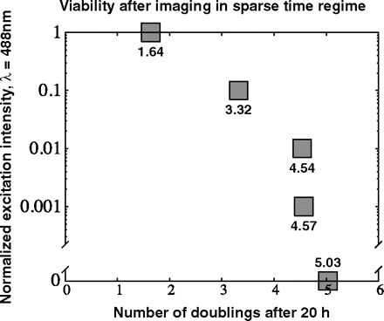
Yeast Viability After Imaging
10 msec exposures, 25 Z slices every 15 sec for 20 min
Carlton et al. PNAS 107(37): 16016 (2010)

Slide 8
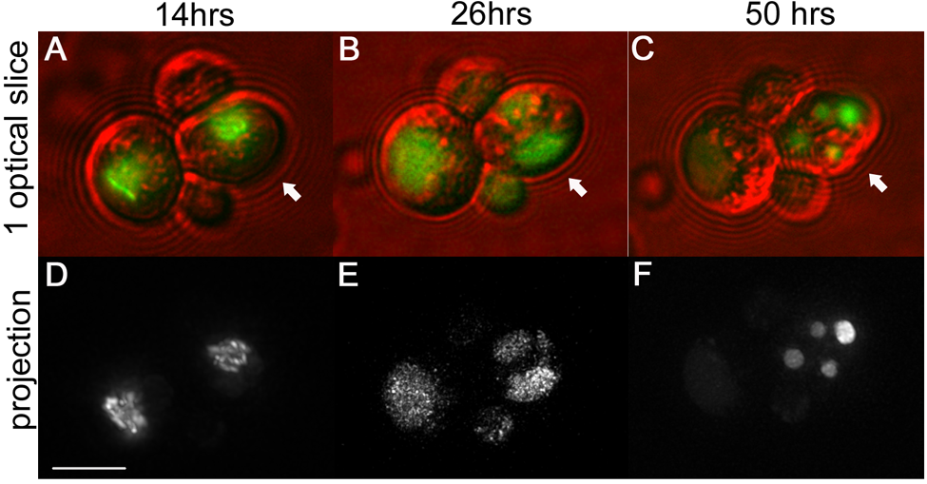
Using Meiotic Progression to Evaluate Phototoxicity
Jennifer Fung

Slide 9
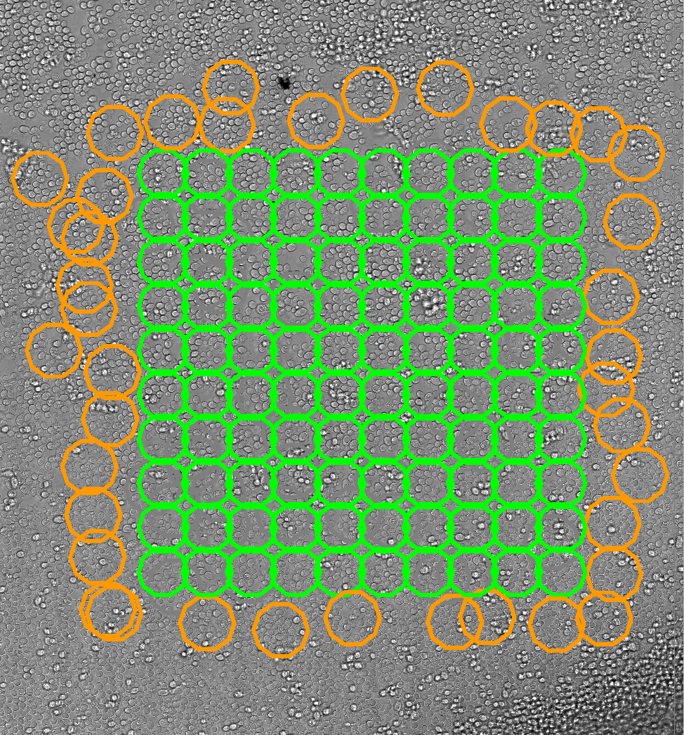
Tetrad Formation 3 fold decreased in imaged areas
Imaged Area
Not Imaged Area
Tetrads
>
3X
1X
Jennifer Fung
Notes:
24 timepoints every hour after 15 -16 every 4 hours (3 fold differences)

Slide 10
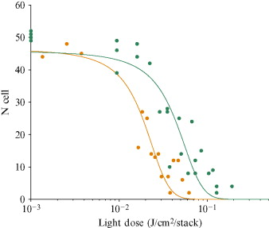
Quantifying Phototoxicity in C. elegans Embryos
Image: 41 Z-slices every 2 min for 2 hours
Count number of nuclei
500 ms exposure
100 ms exposure
Tinevez et al. Meth. Enz. 506: 291 (2012)

Slide 11
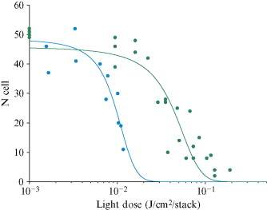
Quantifying Phototoxicity in C. elegans Embryos
Image: 41 Z-slices every 2 min for 2 hours
Count number of nuclei
Widefield
Spinning Disk
Tinevez et al. Meth. Enz. 506: 291 (2012)

Slide 12
Ways to Lessen Phototoxicity and Photobleaching
Reduce signal (shorter exposures, lower intensity)
Reduce frequency of exposures
Remove oxygen and singlet oxygen
Lower noise
Improve detection
Notes:
Reducing signal - like to monitor what is going on, high signal to noise is better but it is a luxury.

Slide 13
Dose Fractionation
If cells can tolerate X amount of light:
Can do 1000 exposures at X/1000
10 Z slices × 100 time points
10 Z slices × 4 colors × 25 time points
Etc.

Slide 14
Reduce frequency of exposures
Bleached/Dead
Bleached/Less Dead
Every 2 min
Every 4 min
Instead of 2x longer before bleaching, you can go 3x as long
Don’t overwhelm endogenous cell antioxidant enzymes
Allow longer time for repair

Slide 15
Minimize Exposure
Gate illumination by camera expose signal so that light is only on while camera is exposing
Requires fast light source (laser or LED)

Slide 16
Minimize Exposure
Gate illumination by camera expose signal so that light is only on while camera is exposing
Requires fast light source (laser or LED)
Mechanical Shutter
Exposing
Camera
Off
On
Light
Off

Slide 17
Minimize Exposure
Gate illumination by camera expose signal so that light is only on while camera is exposing
Requires fast light source (laser or LED)
Fast Triggered Shutter
Exposing
Camera
Off
On
Light
Off

Slide 18
Removing Oxygen and Free Radicals
Oxygen scavengers
Glucose oxidase / Catalase
Protocatechuic acid/protocatechuate-3,4-dioxygenase
Oxyrase (E. coli membrane particles)
Free radical scavengers
Trolox – derivative of Vitamin E
ascorbic acid – Vitamin C
n-Propyl Gallate

Slide 19
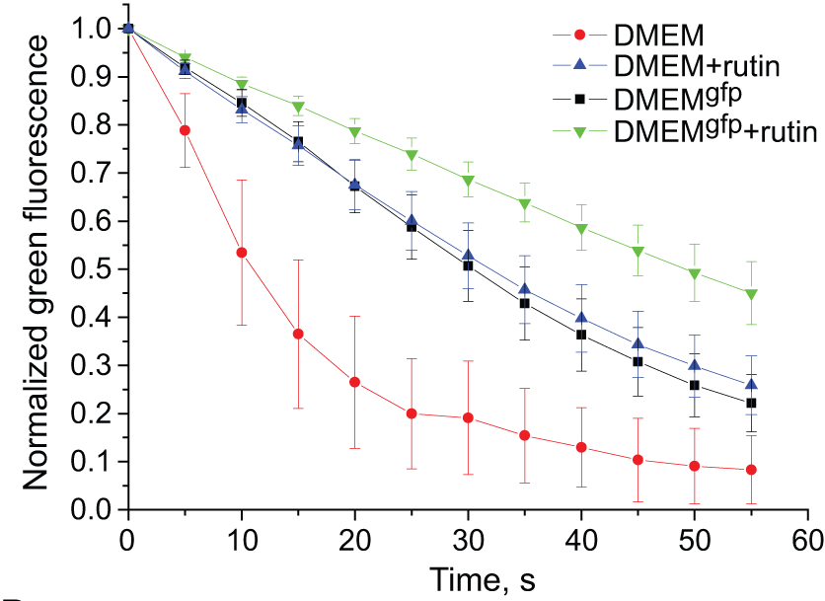
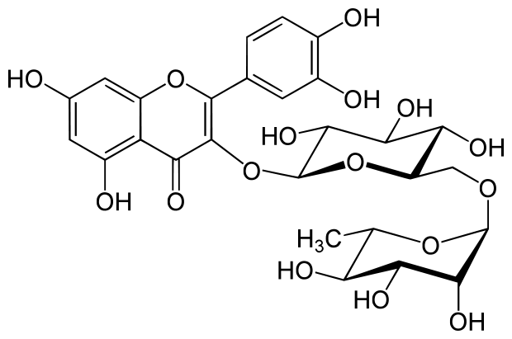
GFP Bleaching in Live Cells
Incubation of cells with rutin 30 minutes prior to imaging increases photostability

Slide 20
Denoising Algorithms
Kervrann – Patch based denoising (ND-SAFIR)
http://serpico.rennes.inria.fr/doku.php?id=software:nd-safir:index
Luisier et al. wavelet denoising (SURE-LET)
http://bigwww.epfl.ch/algorithms/denoise/
Also deconvolution

Slide 21
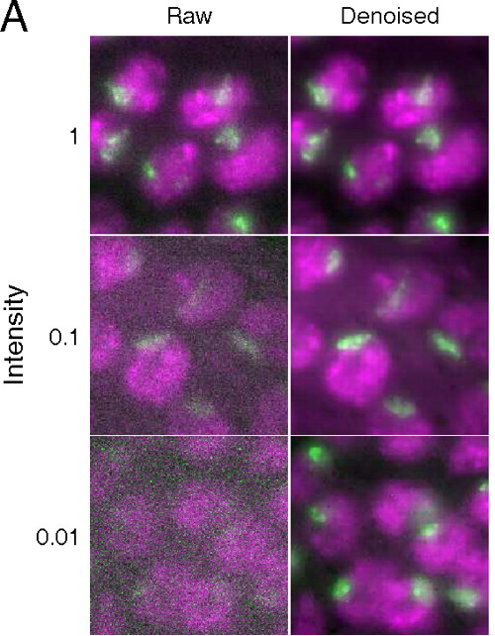
Patch-based denoising

Slide 22
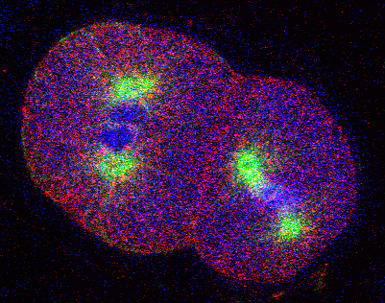
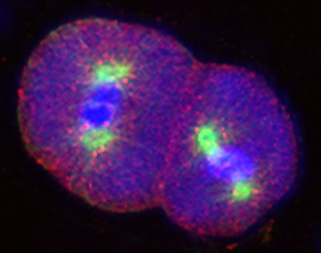
SURE-LET denoising

Slide 23
Preserving a normal environment during imaging

Slide 24
Environmental Variables for Mammalian Cell Lines
Variable | Optimum Range | Comments
Temperature | 28-37ºC | Control with Specimen Chamber Heaters Inline Perfusion Heaters Objective Lens Heaters Environmental Control Boxes
Oxygenation | Variable | Perfuse or Change Media Regularly Use Large Chamber Volume
Humidity | 97-100% | Closed chamber, humidified environmental chamber
pH | 7.0 -7.7 | Use Buffered Media, Perfuse or change media, no phenol red indicator
Osmolarity | 260-320 mosM | Avoid evaporation, sealed chamber
Atmosphere | Air or 5-7% C02 | Use buffered media, closed chamber
Media buffer | Bicarbonate or Synthetic buffers | Beware of phototoxicity, closed & open chambers, atmosphere controlled chamber

Slide 25
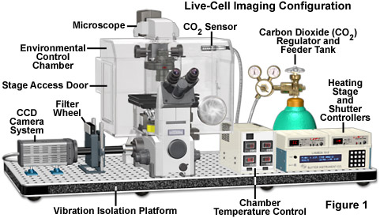
Environmental Chamber

Slide 26
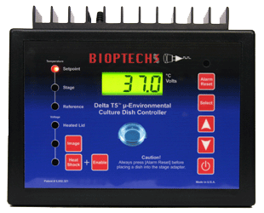
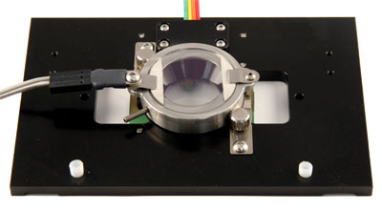
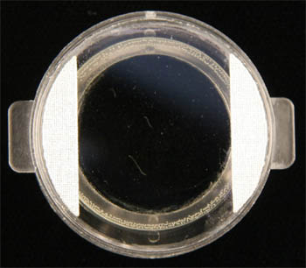
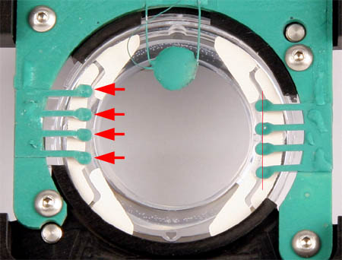
Bioptechs – Open/Closed Dish System
Delta T Dish

Slide 27
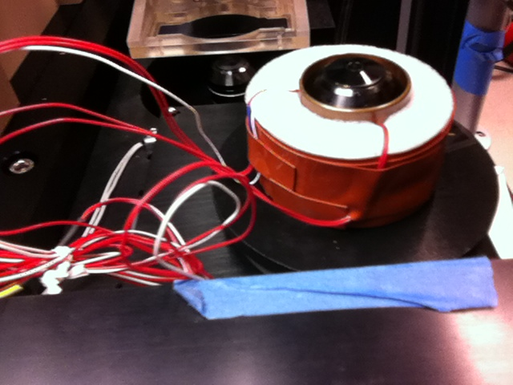
Heated Objective

Slide 28
Custom-made PDMS microfluidics
PDMS - Poly(dimethylsiloxane)
Relatively inexpensive
Easy to use Chemically inert/non-hazardous
Optically clear Flexible and fairly tough when cured
Easily bonded to itself or other materials
Permeable to air and liquids (but can be coated to prevent this).
Notes:
Shrinky dinks

Slide 29
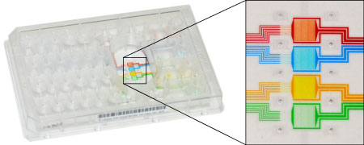
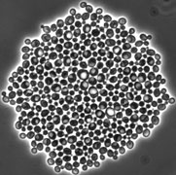
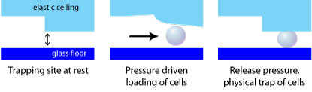
CellASIC – Microfluidic Systems

Slide 30
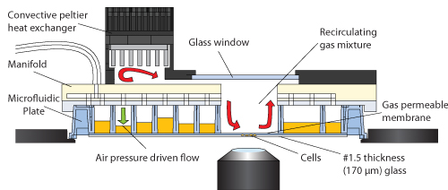
CellASIC – Microfluidic Systems

Slide 31
Different Goals for Fixed vs. Live
Fixed specimens: Optimize the signal/noise
Live specimens: Optimize the signal/noise but without perturbing
your biological process
Notes:
Among the most significant technical challenges for performing successful live-cell imaging experiments is to maintain the cells in a healthy state and functioning normally on the microscope stage while being illuminated in the presence of fluorescent proteins.

Slide 32
Typical ways to improve S/N in fixed samples
Increase exposure time
Amplify signal
Brighter fluorophores/dyes
Decrease photobleaching with antioxidants
>>>> Increase signal

